Slide 1
LDA using
Pokemon Data Set
Term 4 GCD
by Aditya AVS

Slide 2
Story
Given the dataset containing Pokemon Data, use LDA to classify the pokemon types.
It is a very popular dataset and something that all children over the globe enjoyed.

Slide 3
Problem Statement
It is one of the very famous classification problems.
We are going to build a model to make predictions about the
type of the Pokemon(eg: grass type, water type)
whether the Pokemon is legendary or not

Slide 4
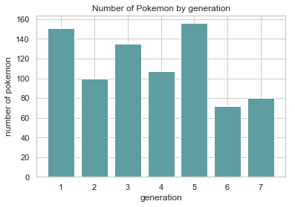
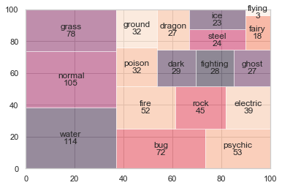
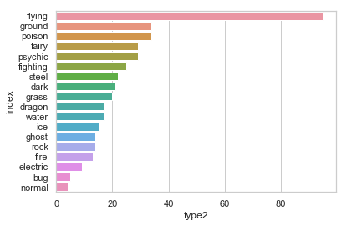
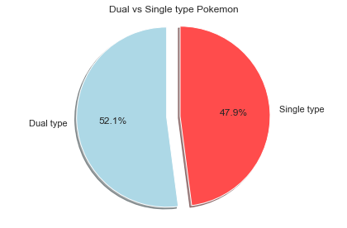
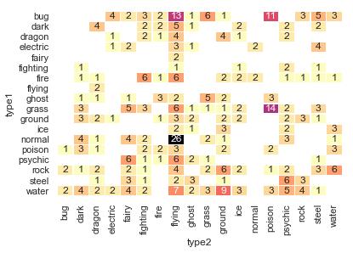
Analysis
The dataset provided has 801 rows and 41 columns

Slide 5
EDA
General Observations
Generation 1, 3 and 5 have relatively higher number of Pokemon introduced
The most common pokemon types are water, normal, grass and bug.
Water Pokemon seems to be a favourite choice because the dataset has a lot of water type Pokemon.
There are very few flying type Pokemon.
Most pokemon only have a primary type but only 52% of pokemon have both primary and secondary abilities (e.g. primary: bug, secondary: flying)
normal + flying, grass + poison, bug + flying and bug + poison are the most common type 1&2 combination
The legendary Pokemon have higher values of attack when compared to normal pokemon. Most of the legendary pokemon have values of attack more than 100 units.

Slide 6
EDA
Pokemon Strength related Observations
dragon, flying, psychic and steel have relatively larger percentage of legendary pokemon
ghost, electric and bug pokemon tend to have lower hp whereas fairy and flying pokemon types tend to have higher hp
On average, dragon type has the highest attack and steel type has significantly higher defense
With reference to the combination of attack and defense:
dragon, steel, rock and ground are among the strongest pokemon type
fairy, psychic and flying are among the weakest pokemon type
There is no strong linear correlation between pokemon size (height & weight) to hp, attack and defense

Slide 7
ML Models used
K-Nearest Neighbours
With PCA
With LDA

Slide 8
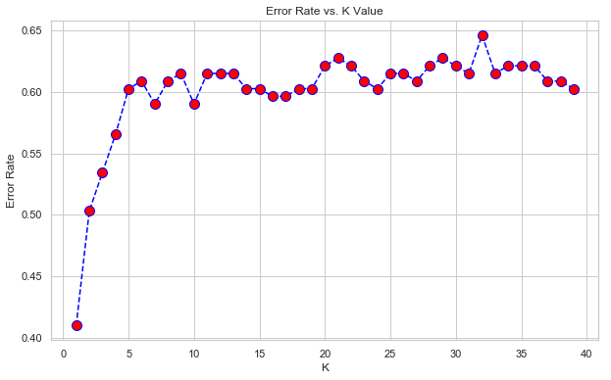
KNN with PCA
KNN
Accuracy of
63.97% for type prediction
93.17% for legendary pokemon prediciton
MAE is
2.3167 for type prediction
0.0683 for legendary pokemon prediciton
RMSE is
2.5983 for type prediction
0.2613 for legendary pokemon prediciton
Optimal number of neighbours
3

Slide 9
KNN with LDA
KNN
Accuracy of
57.14% for type prediction
92.54% for legendary pokemon prediciton
MAE is
2.9440 for type prediction
0.0745 for legendary pokemon prediciton
RMSE is
3.2513 for type prediction
0.2730 for legendary pokemon prediciton
Optimal number of neighbours
3

Slide 10
Conclusion
LDA seems to be working more efficiently for binary classification.
Type Classification Accuracy using PCA 63.97%
Type Classification Accuracy using LDA 57.14%
Legendary Pokemon Classification Accuracy using PCA 93.17%
Legendary Pokemon Classification Accuracy using LDA 92.54%
But PCA alone would serve our purpose

